Slide 1

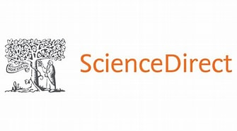
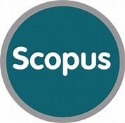
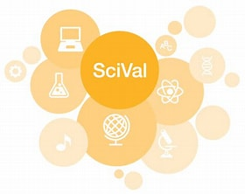
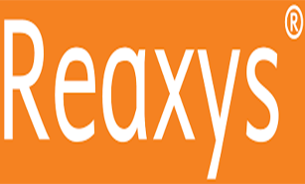
RELX is a global provider of information-based analytics and decision tools for professional and business customers in the Risk, STM, Legal and Exhibitions sectors
Elsevier, founded in 1880, is a leader in information and analytics for customers across the global research and health ecosystems

Slide 2
Research Solutions – Quality Content
Science Direct: The Freedom Collection
  Empowers over 15 million unique users worldwide
  Science Direct offers the largest and highest quality scientific content in the world but also the largest scientific dissemination platform for scientific authors available.
  Currently it provides access from 1995 until present day 2,281 quality titles of which 1,826 are active titles and still its content continues to grow at 5% CAGR annually
  Freedom Collection the best quantitative and qualitative multidisciplinary content available in the market.

Slide 3


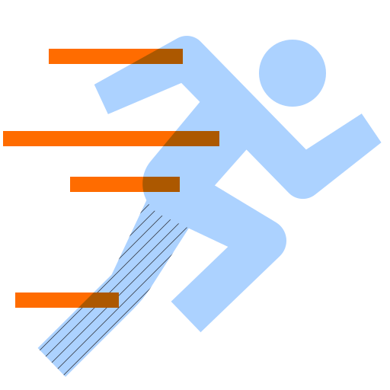

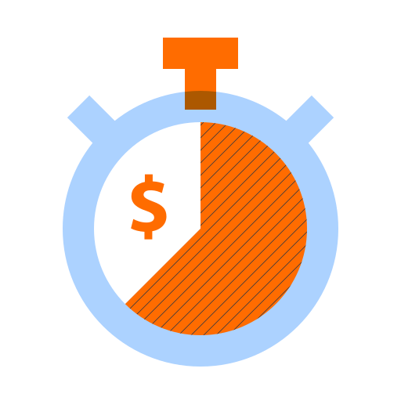
Researchers tell us the knowledge in ScienceDirect Freedom Collection is vital to achieving business outcomes such as:
Innovation
Competitiveness
Speed
Risk Reduction
Effectiveness
Generate new product ideas or enhance existing products
Understand state-of-the-art technology & science
Apply methods / applications of technology from other disciplines in the lab
Use reliable science-based research and data to support project & experimental decisions
Improve manufacturing yield; reduce raw material cost
Apply new technologies from unrelated disciplines
Determine how novel or “patentable” an idea is; support patent applications
Avoid repeating the work of others
Address safety / environmental issues
Design better experiments; validate work against the work of others
Source: SienceDirect: Maximizing Investments & Accelerating The Journey To Research Innovation (an independent research study by Martin Akel & Associates)
https://www.elsevier.com/__data/assets/pdf_file/0003/260895/ScienceDirect-Maximizing-Investments-and-Accelerating-the-Journey-to-Research-Innovation.pdf
Notes:
SPEAKER NOTE; THIS SLIDE IS A BUILD
A few years ago we wanted to better understand the use cases corporate researchers had for consulting the platform and the knowledgebase within so we did a survey amongst existing users of ScienceDirect Corporate Edition. We found there were many different use cases and today I want to share SOME of those use cases with you but in the context of the business outcome they help your organization to achieve:
(CLICK 1)
Let’s first speak to innovation; these are just a couple of ways users tell us they rely upon the knowledge in SDCE to support innovation. For example, to
1. generate new ideas – be those enhancements to existing products or net new product ideas or to
2. apply new technologies from unrelated disciplines – while often this can be for the purpose of problem solving it quite often contributes to innovation (which sometimes comes in the form of problem solving!) – we’ll share some of our users’ tangible examples of this with you in a few minutes.
(CLICK 2)
The knowledge found in SDCE also contributes to your organization’s competitiveness. This could be as straightforward as staying current with science and technology and translating that knowledge into potential applications that benefit your business. This could also be more nuanced in terms of really examining the science in area of IP interest to understand the implications for your strategy – in terms of how patentable an idea might be or informing approaches to circumventing existing patents. There are certainly other ways in which SDCE can contribute to competitiveness but let’s move on to Speed
(CLICK 3)
So often we hear from our users that the knowledge in SDCE helps them uncover whether or not others have previously similar experiments and if so what were the outcomes; this has implications in terms of both cost and time savings by not pursuing dead ends or by being able to move more quickly to the next stage. Additionally that ability to apply knowledge from other disciplines, which we talked about with regard to Innovation, also applies to enabling speed.
(CLICK 4)
In addition to Innovation, Competitiveness, and Speed – the knowledge in SDCE plays a role in risk reduction, for example:
Reliable evidence plays a key role in decision-making, whether it is at a project level or a program level -- it often helps answer those what, why and how questions and helps to explain findings and recommendations
In addition to this the knowledge can help address safety and environmental issues that arise during research and that need to be addressed to avoid risk in gaining market acceptance.
(CLICK 5)
Lastly, let’s look at the role that knowledge from SDCE plays in terms of Effectiveness
Not only does the work of others that have gone before, help researchers design better experiments but also it is a source of inspiration in scaling and manufacturing innovations such that there is greater yield and/or lower costs. We’ll share some examples of this in the next few slides.
(CLICK 6)
Before we move ahead I just want to reinforce these business outcomes again – innovation, competitiveness, speed, risk reduction and effectiveness.
Any questions?
(NEXT SLIDE)
Apply new technologies from unrelated disciplines
Avoid repeating the work of others
Use reliable science bases research and data to support project & experimental decisions
Improve manufacturing yield and/or reduce raw material cost
And what you’ll also see here is the tie between these use cases and business outcomes – innovation, competitiveness, speed to market, risk reduction, effectiveness – all outcomes that underpin business success.
During this research, some of the respondents shared with us actual case examples that they were able to tie, in many instances, to quantitative outcomes, for example (NEXT SLIDE)

Slide 4
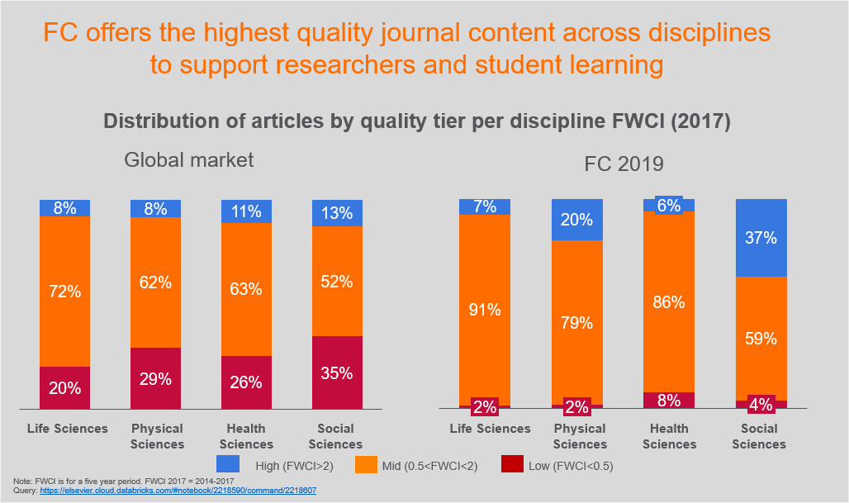
Research Solutions – Quality Content

Slide 5
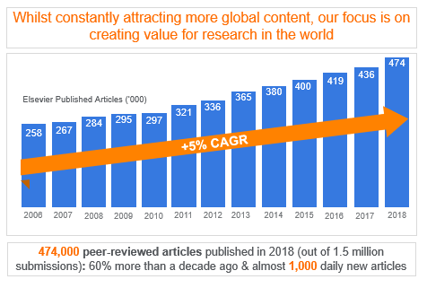
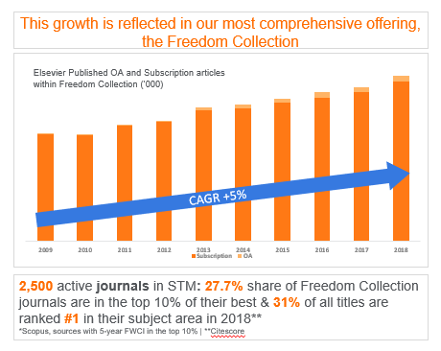
Research Solutions – Quality Content

